Slide 1
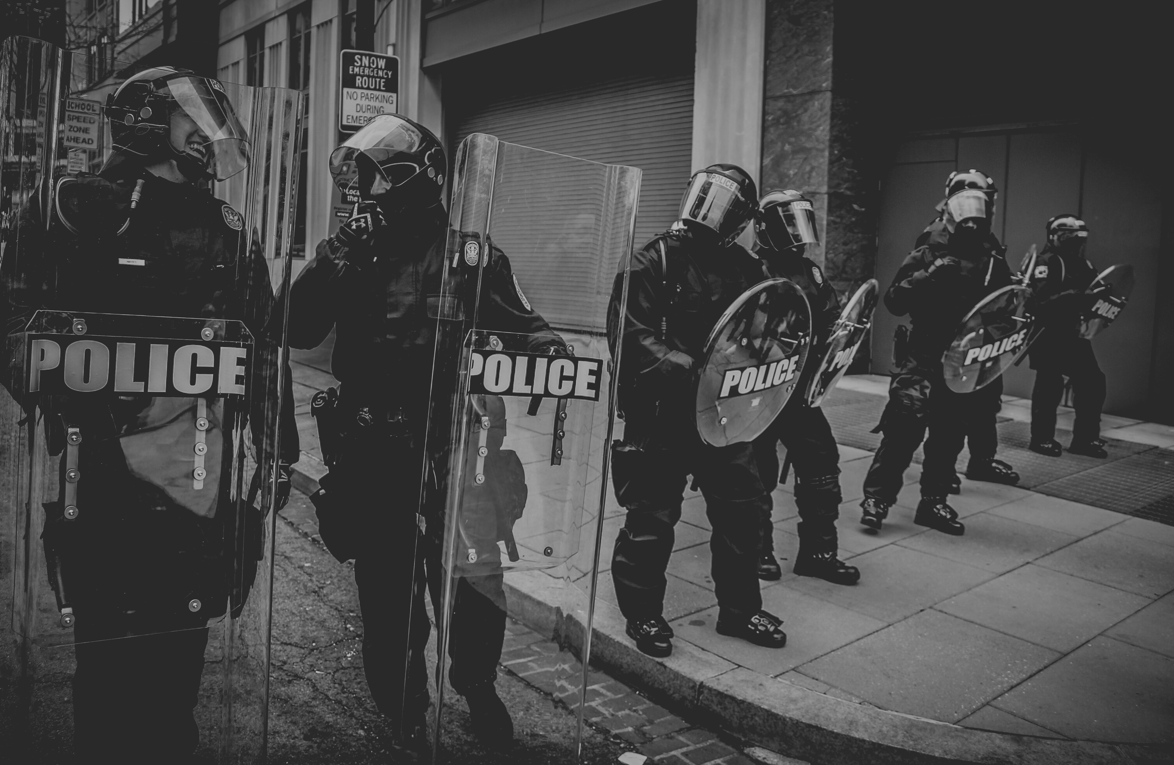

ISHMAEL HO
DAFT,AUG2021
MACHINE LEARNING AND THE WORLD:
L.A.P.D. CRIME PREDICTION AI

Slide 2

KEY DISCUSSION POINTS
The L.A.P.D.
Use of A.I. for Crime Prevention
PredPol
Operation L.A.S.E.R
L.A.P.D.
CRIME PREDICTION A.I.

Slide 3

THE LOS ANGELES POLICE DEPARTMENT
One of the most (in)famous police departments in the US...

Slide 4
THE LOS ANGELES POLICE DEPARTMENT
3rd largest Police Organization in the U.S.
Annual budget of approx. 1.2 Billion US
Earliest adopters of AI for predictive policing
Data from:
https://www.cbsnews.com/news/artificial-intelligence-racial-profiling-2-0-cbsn-originals-documentary/
https://cao.lacity.org/budget20-21/2020-21Proposed_Budget.pdf

Slide 5

A.I. SOLUTIONS IN THE L.A.P.D.
Noteworthy A.I. Initiatives
PredPol Assisted Policing (2010-2021)
Operation L.A.S.E.R (2011-2019)
Data from:
https://www.brennancenter.org/our-work/research-reports/predictive-policing-explained

Slide 6

PREDPOL ASSISTED POLICING
Used historical crime data within the L.A.P.D. jurisdiction.
Model identified areas with higher incidence of certain crimes based on data.
Police Patrols to these areas increased to deter criminal activity.
Data from :
https://digital.hbs.edu/platform-rctom/submission/machine-learning-at-predpol-risks-biases-and-opportunities-for-predictive-policing/

Slide 7

PREDPOL ASSISTED POLICING
Hot-spots based on possibly biased policing data
Data from crime reports could itself be biased for different reasons.
Recommended police patrols of African-American, Latin-American and lower-income areas at double the rate of Caucasian-American dominant areas of a certain economic level.
Data from:
https://themarkup.org/ask-the-markup/2020/08/20/does-predictive-police-technology-contribute-to-bias5

Slide 8

OPERATION L.A.S.E.R.
Used historical crime statistics, arrest data, gang affiliation and other data to identify individuals as "Chronic Offenders"
Identified certain locations as "Chronic Crime Locations" for increased police patrol
Aimed to reduce crime by directing police presence to suppress criminal activity 'precisely'
Data from:
https://themarkup.org/ask-the-markup/2020/08/20/does-predictive-police-technology-contribute-to-bias5

Slide 9
OPERATION L.A.S.E.R.
Like PredPol data was based on decades of crime report and statistical data derived from possibly biased policing.
Increased patrols and data collection in specific areas only served to reinforce the model's assumptions.
Widely viewed as data-driven racial profiling.
Data from:
https://www.cbsnews.com/news/los-angeles-police-department-laser-data-driven-policing-racial-profiling-2-0-cbsn-originals-documentary/

Slide 10
OPERATION L.A.S.E.R. WAS SHUT DOWN IN APRIL, 2019
...
Data from:
https://www.cbsnews.com/news/los-angeles-police-department-laser-data-driven-policing-racial-profiling-2-0-cbsn-originals-documentary/

Slide 11
THE L.A.P.D. ANNOUNCED THE END OF THE PREDPOL PROGRAM IN APRIL,2021
...
Data from:
https://www.cbsnews.com/news/los-angeles-police-department-laser-data-driven-policing-racial-profiling-2-0-cbsn-originals-documentary/

Slide 12
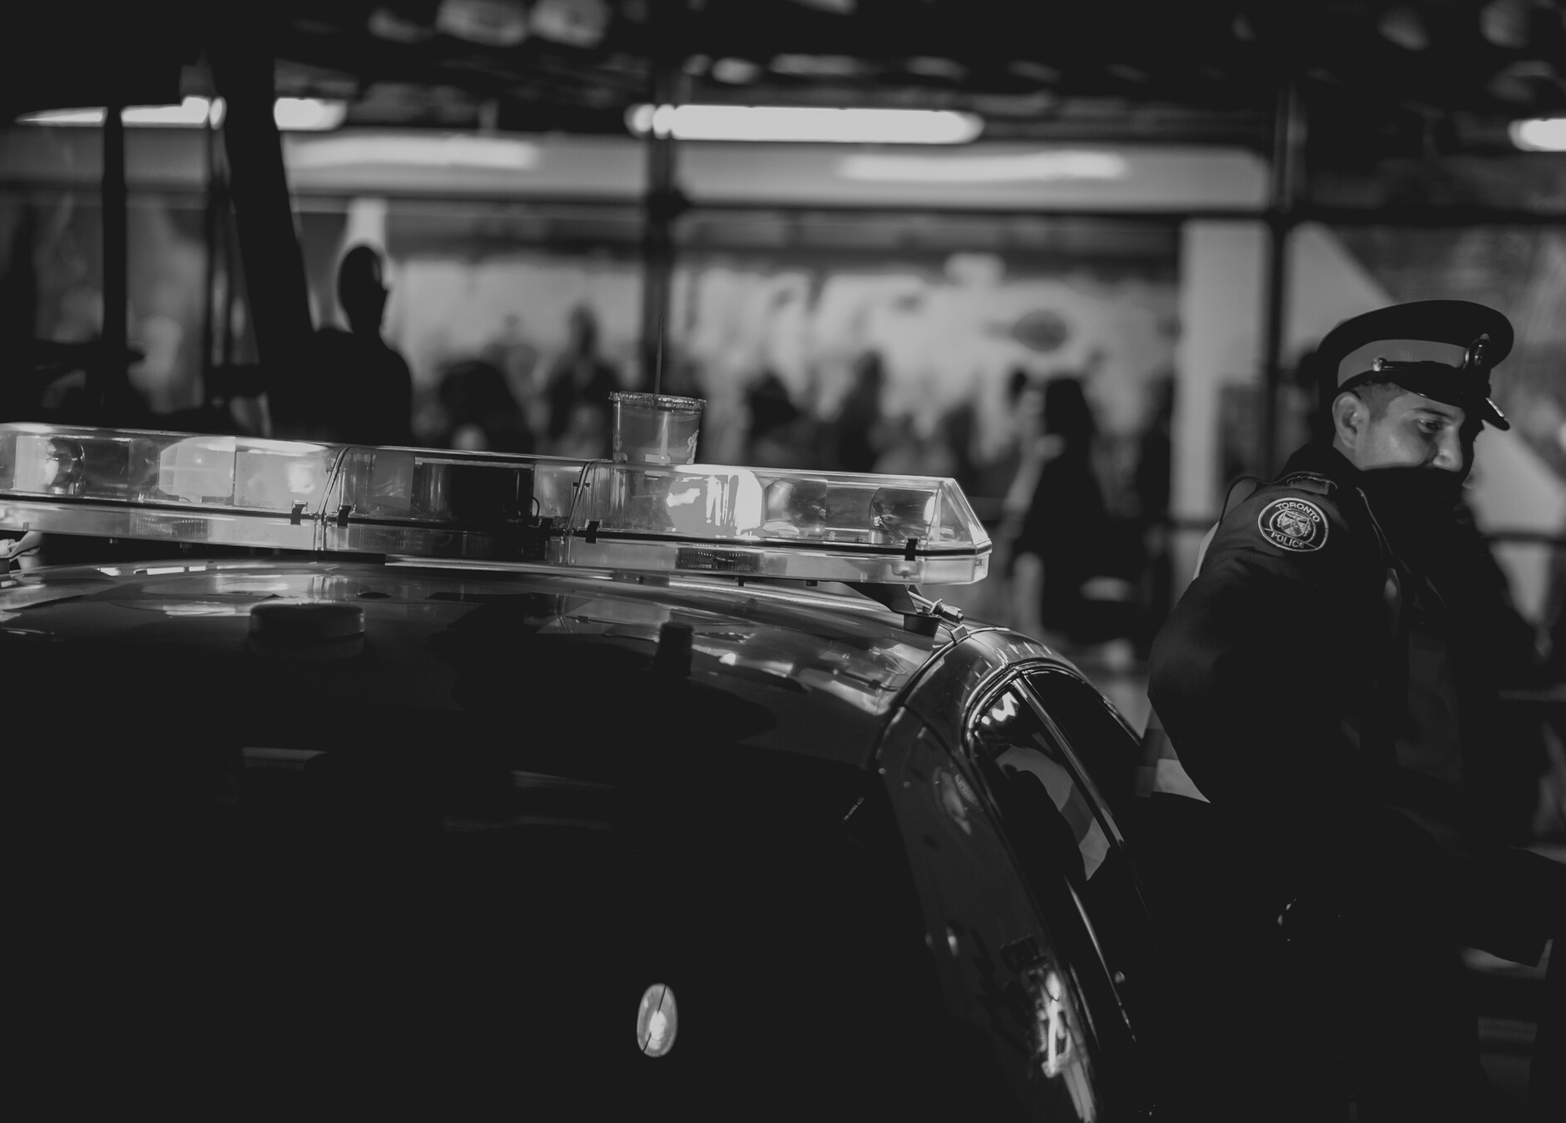
A NEW DEBATE IS BREWING..
The use of facial recognition software in policing is raising concerns among communities which have dealt with biased policing in the past...

